Slide 1



Noida Institute of Engineering and Technology, Greater Noida
Designing Organization for Digital Success
Unit: 4
DIGITAL AND SOCIAL MEDIA MARKETING
Dr. Priyanka Malhotra
MBA Department
MBA III semester

Slide 2

Index/Content
S. No. | Index
1. | Name of Subject with code, Course and Subject Teacher
2. | Brief Introduction of Faculty member with Photograph
3. | Evaluation Scheme
4. | Syllabus
5. | Branch wise Application
6. | Course Objective(s)
7. | Course Outcome(s)
8. | Program Outcomes (POs)
9. | COs and POs Mapping

Slide 3
Index/Content
S. No. | Index
10. | Program Specific Outcomes (PSOs)
11. | Cos and PSOs Mapping
12. | Program Educational Objectives (PEOs)
13. | Result Analysis
14. | End Semester Question paper Templates
15. | Prequisite/Recap
16. | Brief Indtroduction about the Subject with Videos
17. | Unit Contents
18. | Unit Objectives
19. | Topic Objectives/Topic Outcome

Slide 4
Index/Content
S. No. | Index
20. | Lecture related to topic
21. | Daily Quiz
22. | Weekly Assignment
23. | Topic Links
24. | MCQs
25. | Glossary Questions
26. | Old question papers
27. | Expected Questions
28. | Recap of unit

Slide 5

Noida Institute of Engineering and Technology, Greater Noida
Dr. Priyanka Malhotra
Assistant Professor
Department: Management Studies
Email ID: priyankamalhotra@niet.co.in
Qualification: BBA, MBA, UGC NET, Ph.D (submitted)
Specialisation: HRM & OB
Total Teaching Experience: 14 years
Teaching Area: HR and Marketing

Slide 6
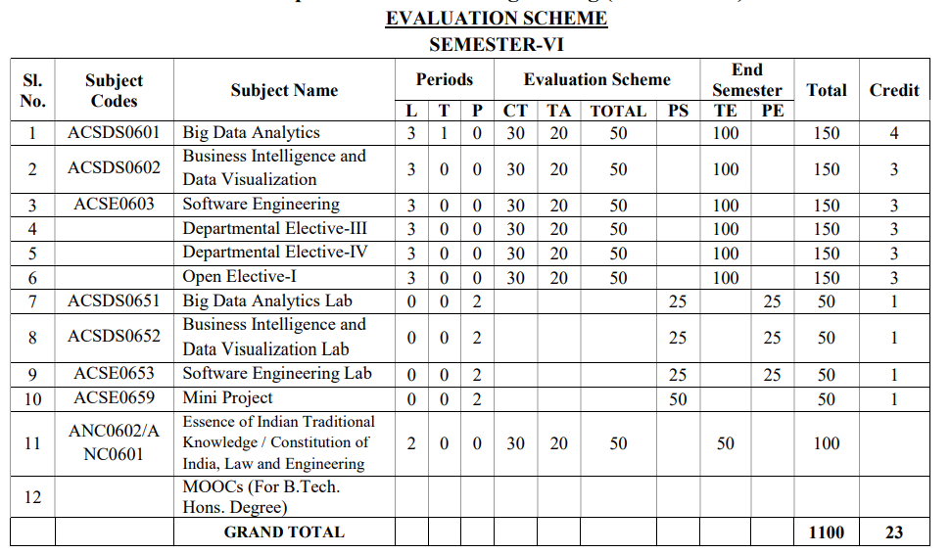
Evaluation scheme

Slide 7

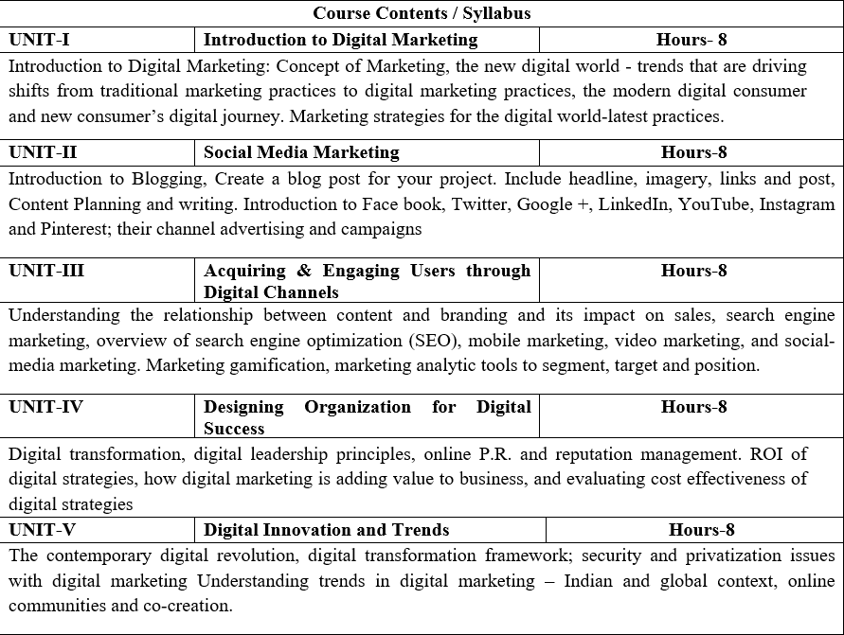
Syllabus

Slide 8
Applications in B Tech
The popularity amongst students from BTECH/MTECH for Digital Marketing is due to the far-reaching benefits that digital marketing provides; This is the main reason that most students from engineering backgrounds are opting for a Digital Marketing career.
Room for Innovation
Great Pay Scale
Demonstrating Problem Solving Abilities
Job Stability
Career Growth
This, in turn, has created many new opportunities for companies to expand their business and has created tremendous employment opportunities across sectors.
As one of the most recently emergent fields, digital marketing has shown immense promise in a relatively small window of time. Combining social media’s benefits and IT soft skills, digital marketers have revolutionized industrial trade and commerce. The broad base and direct interpersonal reach that digital marketing after Btech establishes with its prospective consumer make it one of the most viable and successful marketing modes.

Slide 9
Course Objectives
1 | Provide understanding of digital and social media marketing practices.
2 | Provide understanding of the concept of social media platforms
3 | Impart learning on various digital channels and how to acquire and engage consumers online.
4 | Provide insights on building organizational competency by way of digital marketing practices and cost considerations.
5 | Develop understanding of the latest digital practices for marketing and promotion.

Slide 10
Course Outcomes
CO1 | Students will develop an understanding of digital and social media marketing practices.
CO2 | Students will develop understanding of the social media platforms
CO3 | Students will acquire the skill to acquire and Engage consumers online
CO4 | Students will develop understanding of building organizational competency by way of digital marketing practices and cost considerations
CO5 | Students will develop understanding of the latest digital practices for marketing and promotion.

Slide 11
Program Outcomes
PO1: Apply Knowledge of Management theories and practices
PO2: Foster Analytical & Critical thinking abilities
PO3: Develop Value based leadership
PO4: Understand, analyze and communicate all aspects of business
PO5: Achievement of Organizational goals

Slide 12
CO-PO Mapping
S No | CO/PO | PO1 | PO2 | PO3 | PO4 | PO5
1 | CO1
2 | CO2
3 | CO3
4 | CO4
5 | CO5
 | Avg
High=3,Medium =2 ,Low=1

Slide 13
Program Educational Objectives
PEO1: Conceptual Knowledge to adapt in rapidly changing environment and learn new skills and demonstrate application of management principles in professional work setting.
PEO2: Apply appropriate tools for decision making for solving complex managerial problems in local or global context.
PEO3: Exhibit Integrity, social responsibility and teamwork.
PEO4: Exhibit ethics, communication skills, leadership qualities and entrepreneurial mindset.

Slide 14
Result Analysis
Subject Name & Code | Total No. Of Students | Pass % | 40>65 (%) | 65>75 (%) | 75>90 (%) | 90 & Above (%) | Backlog | Average Marks
Digital Marketing

Slide 15
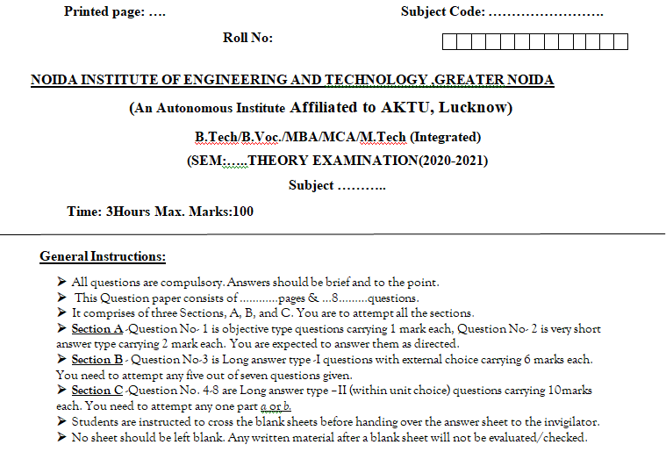
End Semester Question Paper Template

Slide 16
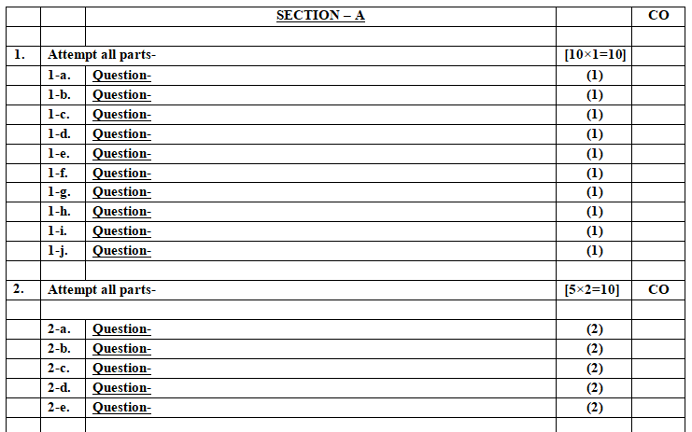
End Semester Question Paper Template

Slide 17
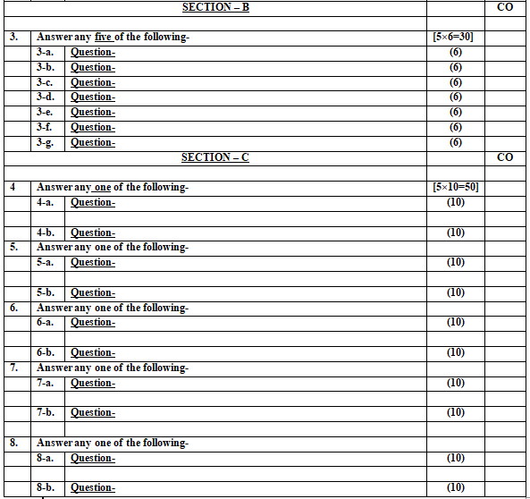
End Semester Question Paper Template

Slide 18
Content
Digital transformation & Digital organization (CO4)
Digital leadership Principles(CO4)
Online P.R. and reputation management. (CO4)
ROI of digital strategies: Evaluating cost effectiveness of digital strategies (CO4)
Digital Value addition.

Slide 19
Prerequisite and Recap
Student should have general understanding of:
1. Digital business
2. Digital technologies
3. Digitalization

Slide 20
Introduction of the subject
The course is designed to make learner conversant with Digital Marketing and proficient in Social Media tools and techniques starting from the fundamentals of digital marketing.
Social media websites and applications allow users to create and exchange user-generated content where people talk, share information, participate and network through technologies such as blogs and social networking sites.
Within the last decade, social media has become one of the most powerful sources for news updates, online collaboration, networking, viral marketing and entertainment.
https://www.youtube.com/watch?v=Xuq6_udbeH0&list=PLi3oNa09iwJRByiNwEJNaZ3XVKcveovzk
https://www.youtube.com/watch?v=X-pCbWwu50k

Slide 21
Objectives of the Unit
To make the students understand the Digital transformation and digital Leadership.
To explain the Online PR and reputation management .
To understand how to calculate ROI of digital strategies.
To develop a basic understanding on Website development.

Slide 22

Noida Institute of Engineering and Technology, Greater Noida
(Unit –IV) Topic 1
Digital transformation & Digital Organization

Slide 23
Objectives of Topics / Session
Students will learn about :
The digital Organization
The Digital transformation and
The digital leadership.

Slide 24
Digital Organization (CO4)
"A digital organisation is one that seeks to improve performance by new and emerging electronic and "information technology" tools, and the business models and new ways of operating that they enable, to improve the effectiveness of how they operate.“

Slide 25
Features of Digital Organization (CO4)
Digital organizations are collaborative, agile, and non-hierarchical.
They are populated by Millennials and digital agents who intelligently work side by side.
Digital organizations need digitally aware and adept leaders who can set the digital agenda and create the context for the digitization of every relevant aspect of their organizations.
Digitization is occurring at an accelerating pace; successful digital leaders need to synchronize their organizations to digital clock speed

Slide 26
Digital Transformation(CO4)
Digital Transformation (DT or DX) or Digitalization is the adoption of digital technology to transform services or businesses, through replacing non-digital or manual processes with digital processes or replacing older digital technology with newer digital technology.
Digital solutions may enable – in addition to efficiency via automation – new types of innovation and creativity, rather than simply enhancing and supporting traditional methods

Slide 27
Digital Transformation(CO4)
In a narrower sense, “digital transformation” may refer to the concept of “going paperless” or reaching a “digital business maturity” affecting both individual businesses and whole segments of society, such as government, mass communications, art, medicine, and science.
The debate surrounding digitalization has therefore gained increased practical importance for politics, business and social issues, and is linked to political work issues for community development, new changes in the practical business .

Slide 28
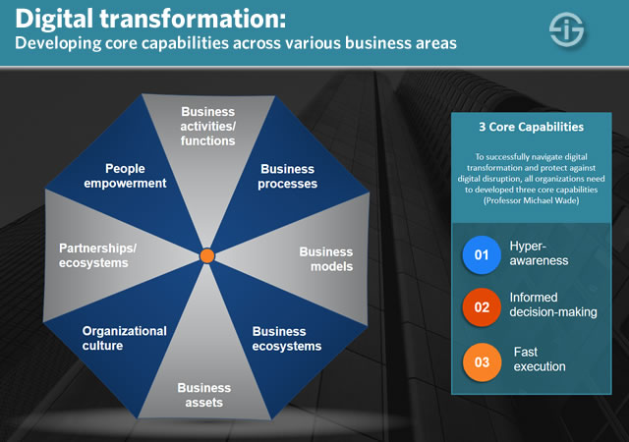
Digital transformation(CO4)

Slide 29
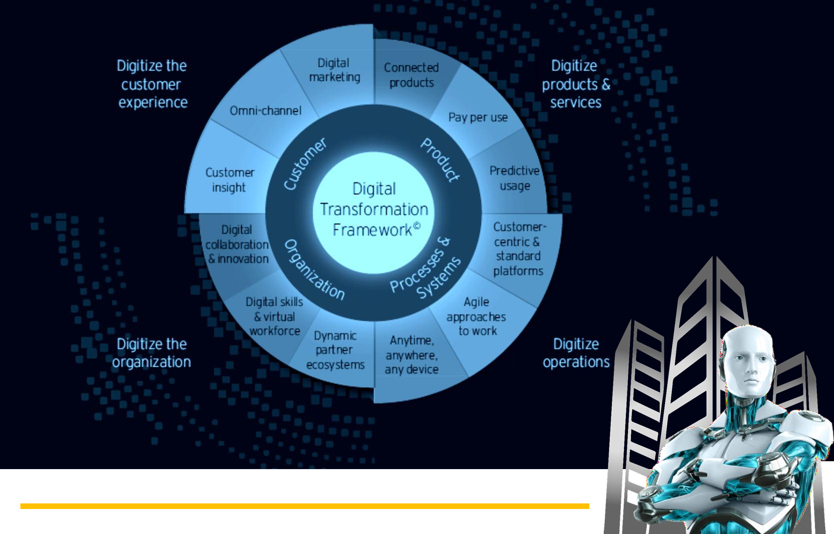
Digital Transformation(CO4)

Slide 30
Need for Digital Transformation (CO4)
The proliferation and convergence of digital technologies like SMACIT (Social, Mobile, Analytics, Cloud and Internet of things) has created significant threats and opportunities to established companies.
Business leaders have started to rethink their business strategies and develop what we refer as digital strategy.
The changing landscape in both private and public enterprises, changing the way organizations assess opportunities, develop and deliver products and services, and interact with customers.

Slide 31
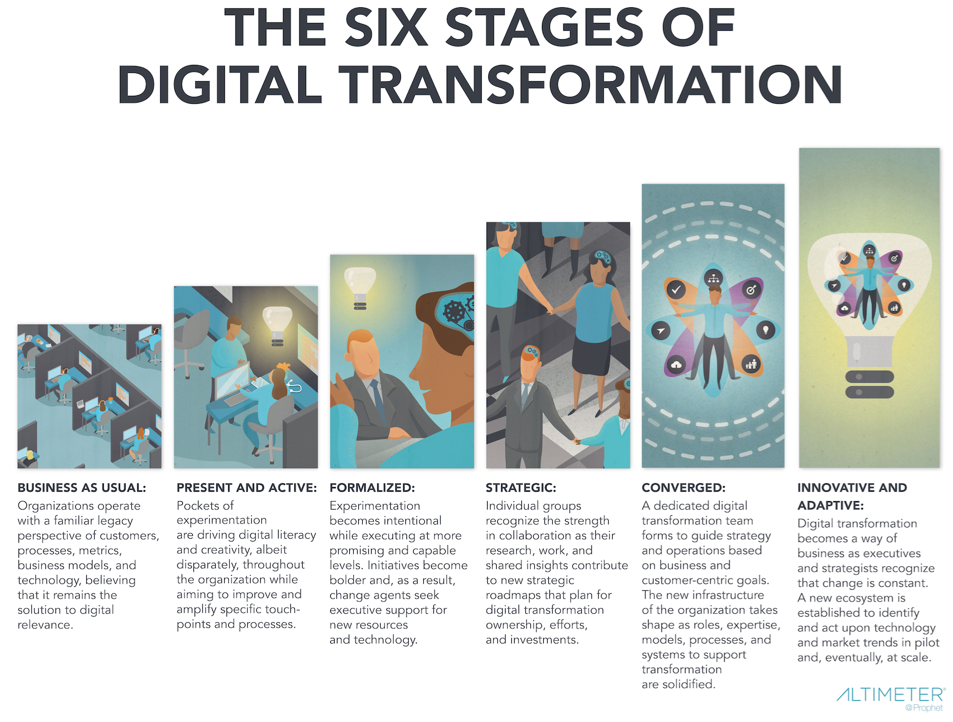
Digital Transformation (CO4)
"A digital organisation is one that seeks to improve performance by new and emerging electronic and "information technology" tools, and the business models and new ways of operating that they enable, to improve the effectiveness of how they operate.“

Slide 32
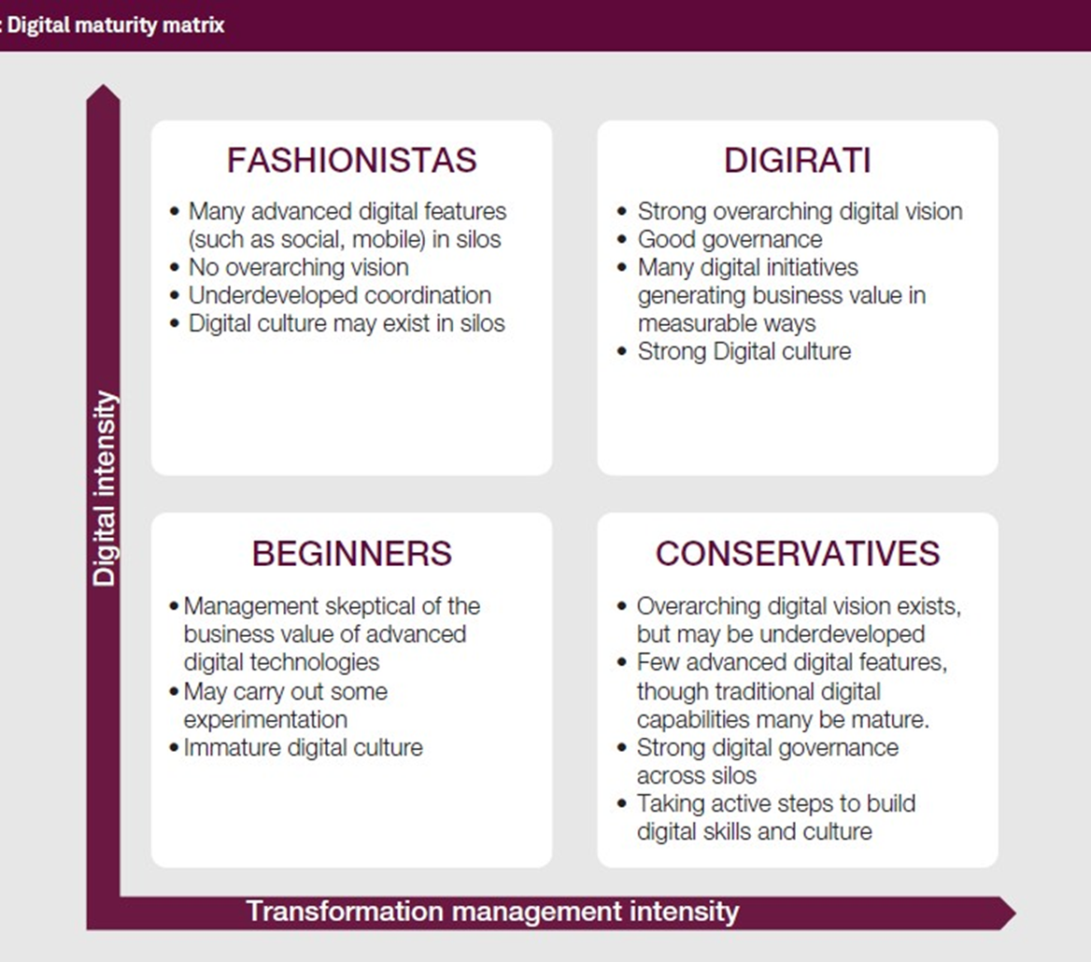
Digital Transformation(CO4)

Slide 33
Daily Quiz(CO4)
_______ is the on-demand delivery of IT resources over the Internet with pay-as-you-go pricing.
IoT stands for ______.
_______ is the process of using digital technologies to create new — or modify existing — business processes
A ______ organisation is one that seeks to improve performance by new and emerging electronic and "information technology" tools

Slide 34
Noida Institute of Engineering and Technology, Greater Noida
(Unit –IV) Topic 2
Digital leadership

Slide 35
Recap
Digital Organization
1.Is a new form of network organization, such as virtual company, virtual enterprise, and virtual factory.
2.An organization that uses digital technology in its internal and external operations. The objective of digital organization is to transform the core of business operations and processes across entire digital organization.

Slide 36
Objectives of Topics / Session
Students will learn about :
The digital leadership.
Progressive leadership

Slide 37
Digital Leadership (CO4)
Digital leadership is the strategic use of a company’s’ digital assets to achieve business goals.
An effective digital leader will be aware of the business goals and knows how their job responsibilities support it.
At an organizational level the digital leader could for example be a company that has successfully taken advantage of their digital assets to gain and also maintain a competitive edge.

Slide 38
Digital Leadership (CO4)
These digital leaders will explore how technology can be used to help their business become much more responsive to the needs of their customers and the ever-changing business requirements.
They place high value on their communication, creativity and willingness to explore the ways that new emerging technology and digital information can be used to help business projects.

Slide 39
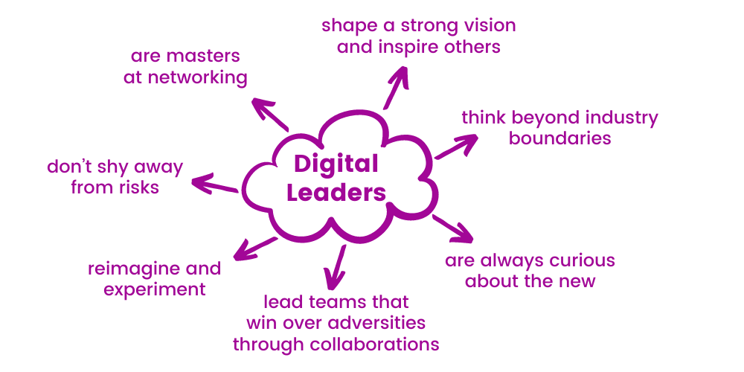
Digital Leadership (CO4)

Slide 40
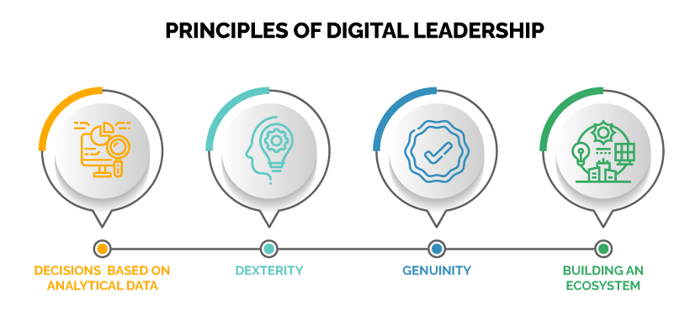
Principles of Digital Leadership (CO4)

Slide 41
Benefits of Digital Leadership (CO4)
It builds a digital culture by giving the departments the right tools.
Makes employees more productive through proper implementation of the tools. Digital leadership ensures that your workforce can concentrate on using it straight away.
Improves customer satisfaction Digital leadership can help this by improving and introducing convenience, speed and customer support, for example. This in turn makes a customer increasingly satisfied with your product or service.
Increases revenue – by serving more customers in less time.
Notes:
Example: Let’s take Google Drive as an example. Companies can use Google Drive to create and access specific documents which contain specific information. Additionally, employees that work remotely can collaborate and share documents via this platform. Each edit that is made is saved and people can see who added, removed or changed any information in real-time.

Slide 42
Roles of a Digital Leader (CO4)
As a digital leader, you will:
Set the vision
Influence executives and stakeholders
Create sustainable digital programs
Define processes for digital excellence
Track impact
Optimize and continually improve

Slide 43
Case study of a Digital Leader (CO4)
Burberry in 2006 was an organization that was markedly underperforming against its peer group. It brought in a visionary digital leader, Angela Ahrendts, to help recover the group and she did so through the use of digital transformation. In particular, she implemented the following changes:
Re-aligned Burberry to target the millennial audience. This enabled digital to play a much larger role.
Re-launched the brand in a digitally savvy way based on what consumers wanted.
Brought out the essence of the brand through digital and music.
Re-designed the online and offline journey to be seamless. The in-store experience was like walking into their website.
Set the pace and vision that digital was a way of life at Burberry.

Slide 44
Digital Marketing is adding Value to Business(CO4)
Improved Customer Service
Get Valuable Data and Analytics
Higher Conversion Rates and Increased Revenue
Being on Par with Competitors
Preparedness for the Internet of Things
Notes:
Digital Marketing is your most excellent tool to maintain your own business growth chart higher. Digital marketing is being embraced through the use of social media, SEO services, responsive websites, and email marketing.

Slide 45
Digital Marketing is adding Value to Business(CO4)
Global reach
Lower cost
Traceable, measurable results
Personalization
Improved conversion rates

Slide 46
Cloud Computing (CO4)
One example of digital transformation is the use of cloud computing.
This reduces reliance on user-owned hardware and increases reliance on subscription-based cloud services.
Some of these digital solutions enhance capabilities of traditional software products (e.g. Microsoft Office compared to Office 365) while others are entirely cloud based (e.g. Google Docs).

Slide 47
Internet of Things (CO4)
The term IoT is mainly used for devices that wouldn't usually be generally expected to have an internet connection, and that can communicate with the network independently of human action. For this reason, a PC isn't generally considered an IoT device and neither is a smartphone -- even though the latter is crammed with sensors. A smartwatch or a fitness band or other wearable device might be counted as an IoT device, however.

Slide 48
Daily Quiz
1..Digital business is similar to the term __________ which was first coined by IBM corporation.
A. E‑business
B. E-Commerce
C. Internet Business
D. Both A and B
2. Digital business Infrastructure refers to the combination of ________
A. Hardware
B. Software
C. Servers
D. All of the above
3. ________ is an organization that uses technology as a competitive advantage in its internal and external operations.
A. Digital Economy
B. Digital enterprise
C. E-commerce
D. None of the above

Slide 49
Daily Quiz
4. _______ is NOT an example of Digital Business.
A. OYO Rooms
B. Reliance SMART
C. Ola
D. D Mart Ready
5. The scope of e‑commerce is ________ than digital business.
A. Broader
B. Narrower
C. Wider
D. Hyper

Slide 50
Noida Institute of Engineering and Technology, Greater Noida
(Unit –IV) Topic 3
Online PR and reputation management

Slide 51
Recap
The transformation stage means that digital usages inherently enable new types of innovation and creativity in a particular domain, rather than simply enhance and support traditional methods. Companies can do much more to gain value from investments they have already made, even as they envision radically new ways of working.

Slide 52
Objectives of Topics / Session
Student will learn about Online PR and reputation management.

Slide 53
Online PR (CO4)
Online PR (online public relations) is the public relations work of communicators via available online communication channels (and also communication tools). In addition to the online pages of classic media, these channels include social media, blogs and websites. Based on the measures taken in the print sector, the possibilities and opportunities offered by online media are used and the strategies are adapted accordingly.
Notes:
Online PR can be a great, low-cost technique for making more people aware of your brand or website, but it requires a lot of hard-work - there are no short corners.

Slide 54
Online PR (CO4)
Digital PR is an online marketing strategy used by businesses to increase their online presence. Digital PR agencies network with journalists, bloggers and influencers and send online press releases to gain high-quality backlinks, social media mentions and improve their Search Engine Optimisation (SEO).

Slide 55
Online PR (CO4)
Digital PR is a sub-service of Content Marketing. Digital PR involves:
gaining high-quality backlinks from websites and online publications
gaining publicity online
earning honest (hopefully good) customer reviews
responding with comments to requests from journalists.
Content Marketing, in comparison, refers to all of the digital PR techniques — and content creation such as blog posts, webpage copy and knowledge bases.

Slide 56
Online PR (CO4)
The aim is to have a lasting positive impact on the external image of a company or brand. In addition, some partial objectives can be defined:
acquisition and retention of new customers
communication of information
increase of attention
creating a high cost-benefit ratio
improving (online-) reputation
measuring and controlling success

Slide 57
Online PR (CO4)
Digital PR is an evolved form of PR. Instead of targeting only print publications, digital PR focuses on online publications and increasing brand awareness. It includes:
publishing articles and press releases
working with bloggers and influencers on product features and reviews
affiliate marketing
nurturing journalist and content writing contacts to secure press hits
using social media to gain exposure
building brand trust through online reviews.

Slide 58
Online PR (CO4)
How does Online-PR work?
PR firms realign brands, reposition products and bring companies into the spotlight
With the right stories and the right press releases, we reach the desired target group for online PR.
They also develop strategies that bring you and your target group together and send them on a journey to your product.
In the social media sector, they combine the rules of the web with your goals in terms of search engine optimization (SEO), marketing and much more.
In addition, they recruit influencers from a wide variety of industries, whether large or small, global or local. Always the right tool for a unique positioning of your brand!

Slide 59
Online PR and reputation management(CO4)
Public relations (PR) can help raise your business’ profile and improve your reputation. If done well, it can be a cost-effective way to get your message to a large audience.
Online Public Relations (E-PR, Digital PR) functions the web relationship influence among the cyber citizens and it aims to make desirable comments about an organization.
Compared with traditional public relations channels (such as TV, radio and printed press), the network systems used for online public relations vary from search to social platforms.
https://www.youtube.com/watch?v=IZixqBZ8HoY
https://www.youtube.com/watch?v=p1in8uuAu7g

Slide 60
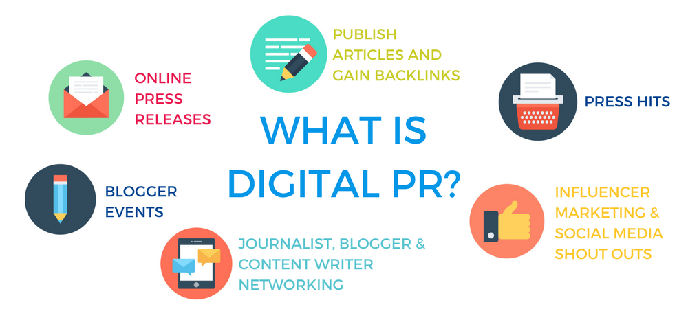
Key Techniques for Online PR (CO4)

Slide 61
Public Relation(CO4)
Benefits of public relations (PR)
Influence
Reach
Cost-effectiveness
Challenges of public relations (P.R)
No direct control
No guaranteed results
Evaluation

Slide 62
Online Reputation Management (ORM) (CO4)
Your online reputation is how others see you when they look for you online.
Google yourself. What do you see?
Are you represented fairly?
Everyone has an online reputation.
Online reputation management (ORM) means taking control of the online conversation. Its techniques and strategies ensure that people find the right materials when they look for you on the Internet.
The purpose of online reputation management is to create balance, counteract misleading trends, and allow you to put your best foot forward.

Slide 63
Online Reputation Management (ORM) (CO4)
Online reputation management (ORM) is the practice of crafting strategies that shape or influence the public perception of an organization, individual or other entity on the Internet. It helps drive public opinion about a business and its products and services.
Reputation handlers can build extensive website projects to distribute text, video or other elements, or use social media analytics to determine a company’s status before engaging in products that influence reputation on a social media platform like Facebook or Twitter.

Slide 64
Online Reputation Management (ORM) (CO4)
Online reputation management (ORM) is when, in order to address any negative or false comments, you actively monitor mentions of your brand on websites and social media.
ORM mainly works by responding to negative customer comments online and reacting to stories in the media (both social and traditional) that paint your company in a bad light.
For example, you might release a public statement addressing the content of the story or publish a social media post in response.

Slide 65
Online Reputation Management (ORM) (CO4)
The hits a brand takes online can be numerous, but they’re often small attacks—a negative comment here, a low star rating there.
None of these blows is worth a full-scale PR campaign, but they add up quickly.
You need online reputation management to take care of each of these little fires before they amount to serious damage.
ORM is also important for maintaining transparency—a vital ingredient of brand loyalty in 2020.
With online reputation management, your business combats negative claims by addressing them directly and openly.

Slide 66
Online Reputation Management (ORM) (CO4)
Two cycles of online reputation
Vicious Cycle: Ignore your online reputation and you risk falling victim to a vicious cycle of misinformation and rumors.
Virtuous Cycle: Take care of your online reputation and you create a virtuous cycle of positive, quality materials that reflect well on you.
https://www.reputationdefender.com/what-online-reputation-management

Slide 67
Online Reputation Management (ORM) (CO4)
5 Online Reputation Management Strategies You Can Use:
1. Answer Promptly and With Empathy.
2. Address Negativity Up Front.
3. Own Up To Your Mistakes
4. Stay on Top of Your Search Results
5. Automate Online Reputation Management.

Slide 68
Online Reputation Management (ORM) (CO4)
How ORM is different from PR
PR firms work externally, such as through advertising and coordinated media promotional efforts. It’s mostly a proactive effort to strengthen brands instead of minimizing attacks on companies (though PR firms do sometimes handle damage control).
Online reputation management, on the other hand, is most often reactive. It involves looking for and responding to potentially damaging content from other people or companies.
Most of the work that goes into ORM is handled internally by brands rather than by an external firm.
Notes:
Both public relations (PR) and online reputation management have the same goal: portraying the company in the best possible light. The main difference between the two is how they achieve that goal.

Slide 69
Online Reputation Management Case study (CO4)
Case Study: United Airlines
One company that understands this better than most is United Airlines, which is still trying to find its footing after being deemed “evil” on social media. In 2017, video of United Airlines security personnel violently dragging a passenger off of an overbooked flight went viral, generating over 1 million mentions a day on Facebook, Instagram, and Twitter in the immediate aftermath. This social media storm ignited national outrage and caused United’s stock to quickly lose more than $1 billion in market value. While the stock has since recovered, the company’s reputation remains tarnished and continues to serve as fodder for late-night comedians.

Slide 70
Daily Quiz
Online PR is ______.
State the relevance of Reputation management in Digital Marketing.
__________ is the practice of crafting strategies that shape or influence the public perception of an organization, individual or other entity on the Internet.
State any 2 key characteristics of Online PR.

Slide 71
Noida Institute of Engineering and Technology, Greater Noida
(Unit –IV) Topic 4
ROI of digital strategies

Slide 72
Recap
Public relations (PR) can help raise your business’ profile and improve your reputation. If done well, it can be a cost-effective way to get your message to a large audience.
Online PR can be a great, low-cost technique for making more people aware of your brand or website, but it requires a lot of hard-work - there are no short corners.

Slide 73
Objectives of Topics / Session
Student will be able to digital strategic system and ROI of digital strategies .

Slide 74
Digital Strategies (CO4)
There are four keys to successfully defining and executing digital strategy
Zeroing in on a customer engagement or digitized solution strategy to guide the transformation
Building operational excellence
Creating a powerful digital services backbone to facilitate rapid innovation and responsiveness
Ensuring ongoing digital redesign

Slide 75
ROI of Digital Strategies(CO4)
Return on investment (ROI) is an important part of digital marketing (and really, almost every part of marketing)—it tells you whether you're getting your money's worth from your marketing campaigns.
Marketing ROI is the practice of attributing profit and revenue growth to the impact of marketing initiatives.
By calculating return on marketing investment, organizations can measure the degree to which marketing efforts contribute to revenue growth. Typically, marketing ROI is used to justify marketing spend and budget allocation for ongoing and future campaigns and initiatives.
https://www.youtube.com/watch?v=cT42N8scarQ
Notes:
One of the most important components of a marketing campaign is to evaluate its performance and impact and profit so that it can be determined whether or not your marketing efforts are actually helping the company improve its bottom line.

Slide 76
ROI of Digital Strategies(CO4)
To understand what the ROI is, we need to understand what the goals or aims of the company are, what they wish to get from a digital marketing campaign and then measure these goals. For this we need to look at the Key Performance Indicators (KPIs) and the goals for each one.
Your digital marketing’s ROI is a measurement of your online marketing campaign’s profits or losses, which you calculate with the following formula: (net profit / total digital marketing costs) x 100.

Slide 77
ROI of Digital Strategies(CO4)
Measuring your online marketing ROI helps you determine the effectiveness of your strategies.
The fundamental formula for calculating your digital marketing ROI is:
ROI = (Gains from investment - cost of investment)/(cost of investment) × 100%

Slide 78
ROI of Digital Strategies(CO4)
Here are some types of key performance indicators:
General Performance – Traffic, leads, Reach.
Channel Based – Website, blog, social networks, search engines.
Source based performance – Direct traffic, Organic search, referrals, email, PPC.
Campaign based performance – Lead generation, click through, conversions, conversion rates.
Setting realistic and measurable goals.

Slide 79
Tools for measuring ROI (CO4)
1. Google Analytics: Content ROI
If you run a website, Google Analytics is simply a must-have tool. It helps you to track every source of traffic to your website pages. Some important metrics you get from your Google Analytics dashboard are:
Page views
Bounce rates
Visitors location
Source of traffic
https://www.youtube.com/watch?v=mreOWm3e9lg
2. Cyfe
This is another tool that helps you to prove your digital marketing ROI across various marketing channels: Advertising, Blogging, Email, Sales & Finance, SEO and Social media

Slide 80
Tools for measuring ROI (CO4)
Social media marketing ROI
3. Hootsuite
In most cases, a business will maintain a presence in many social media platforms. It can be tedious to track your results on these social media channels individually.
4. Sproutsocial
You can measure your social media metrics on this platform as well. Apart from creating goals on Google Analytics, you need to have the knowledge of your performance.
Notes:
With a tool like Hootsuite, you can manage your social media pages on a single platform and also track results from your social media efforts.
This would include the types of content with the highest engagement, the low performers, number of impressions, number of clicks to your website, and other important metrics.

Slide 81
Tools for measuring ROI (CO4)
Search Engine Marketing RPO
Gaining organic traffic from search engines to your website is crucial. Because it’s a targeted source of traffic with people searching keywords related to your service, this will certainly boost your digital marketing results.
5. SEMrush
Apart from being one of the most popular keyword research tools today, you can also use SEMrush to get insights from your organic traffic. With its Organic Traffic Insights tool, you can get details about the number of users who visit your website through search engines.
6. Sleeknote
When you have the basic numbers about your email performance and your investment value, Sleeknote can help you calculate important email results and your digital marketing ROI.

Slide 82
Evaluating Cost effectiveness of digital Strategies(CO4)
Measuring against goals
The first step to understanding the cost effectiveness ratio of your digital marketing. If you’re paying a blogger to share a product testimonial and you only get 6 new followers from their efforts – that might seem like an expensive campaign metric
If your goal was more followers, but it might be a more valuable investment – new fans – than simply generating clicks which are a lower form of engagement.
Measuring cost-effectiveness will always depend on your goals and your results.

Slide 83
Evaluating Cost effectiveness of digital Strategies(CO4)
Understanding not all cost is monetary
While most people performing a cost-effectiveness analysis of their digital marketing efforts might simply try to understand campaign bottom-line dollars spent per impression, other businesses understand that the time it takes to brainstorm campaign concepts, create content, design digital advertising all have an inherent “cost” in the form of time or salary.
The cost of marketing is beyond the money paid to a publisher to promote a piece or host an ad – don’t forget to factor in the “hidden” costs of creating digital marketing content.
.

Slide 84
Evaluating Cost effectiveness of digital Strategies(CO4)
Use a cost-benefit analysis template
Whether it’s an old-fashioned worksheet or a high-end software, strategizing the cost-benefit of a project before it’s ever launched can help you strategize the most cost-effective concepts to begin with.
Using a cost-benefit analysis spreadsheet or software helps you understand the strengths, weaknesses, and alternatives for your idea, which makes it easier to calculate the risks and possible ROI.

Slide 85
Daily Quiz
1. ROI stands for ________.
The fundamental formula to calculate ROI is _______.
_____ is a tool to measure Content ROI.
Hoot suite is a tool to measure ROI of Social media. (True/ False)
Cyfe is a tool to measure ______ ROI.

Slide 86
Topic Links and Online Courses details
https://www.youtube.com/watch?v=508CR1fd8ws
https://www.youtube.com/watch?v=YWA-xbsJrVg
https://www.youtube.com/watch?v=yD24fofvvVg
https://www.coursera.org/courses?query=digital%20transformation
https://www.coursera.org/search?query=website%20development&

Slide 87
MCQs
The correct abbreviation of ROI is __________.
Risk on Investment
Return on Investment
Risk on Income
Return on Income
2. __________ falls under the A/B testing tools.
Google Content experimentation
Visual Website Optimization
Both of these
None of these
3. Digital business Infrastructure refers to the combination of ________
Hardware
Software
Servers
All of these

Slide 88
MCQs
4. IoT stands for ____.
Information Of Things
Input Output Things
Internet of Technology
Internet of Things
5. The transformation of key business processes through the use of digital or Internet technologies is known as ____________
E business
E commerce
Digital business
Both a and c

Slide 89
Glossary
i) IoT ii) digital leader iii) Digitalization iv) hierarchical
1. _______ is the adoption of digital technology to transform services or businesses by replacing manual processes with digital processes.
2. The term _______ is used for devices that wouldn't usually be generally expected to have an internet connection.
3. The _______ could be a company that has successfully taken advantage of their digital assets to gain and maintain a competitive edge.
4. The most common website structure is a ________ one that is based on one parent page and child pages.

Slide 90
Sessional Question paper (Online)
Objective Paper https://forms.office.com/r/kNi2FiFC0f
Subjective Paper
https://forms.office.com/r/h8K7Auphdm

Slide 91
Sessional Question paper

Slide 92
Sessional Question paper

Slide 93
Sessional Question paper

Slide 94
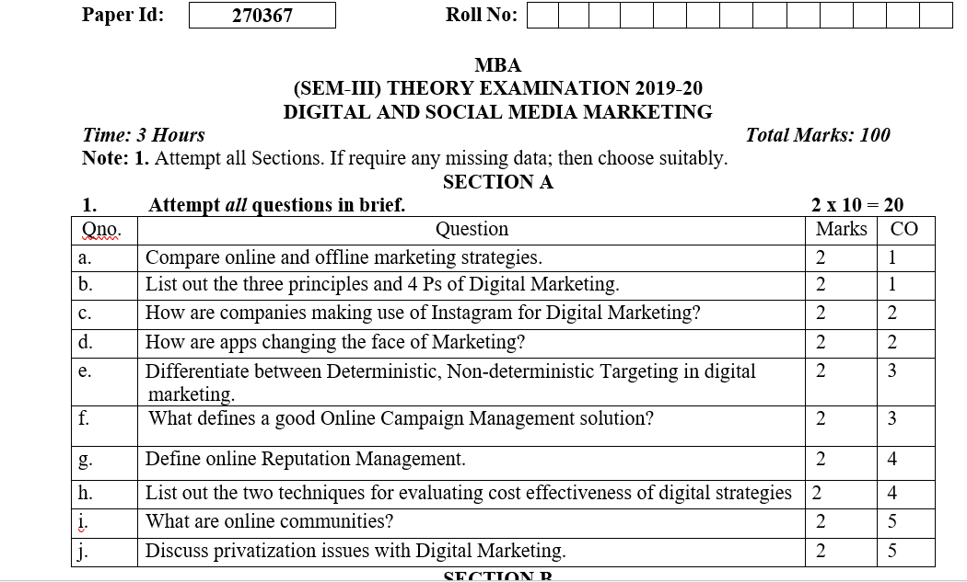
End Semester Question paper

Slide 95
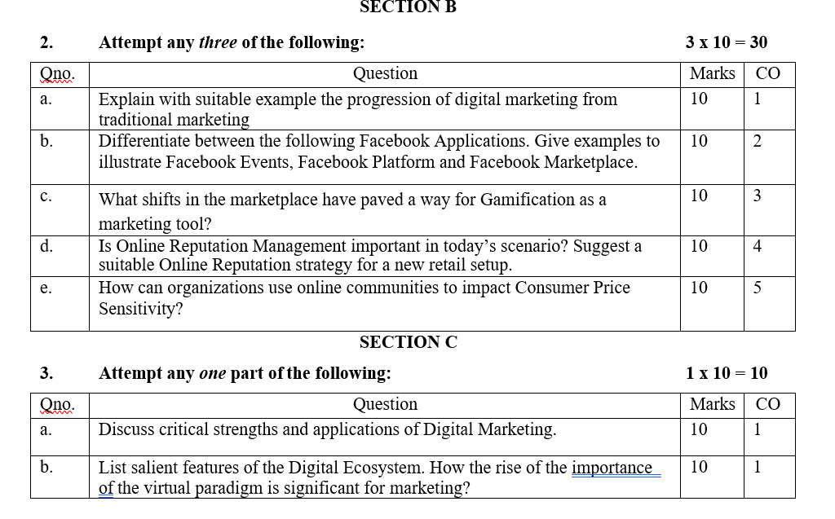
End Semester Question paper

Slide 96
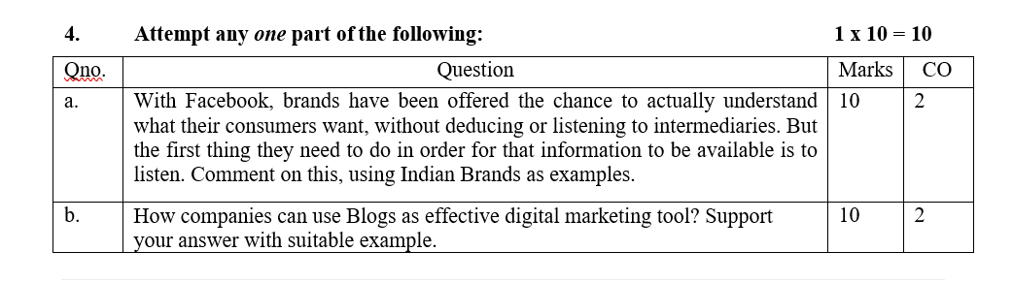
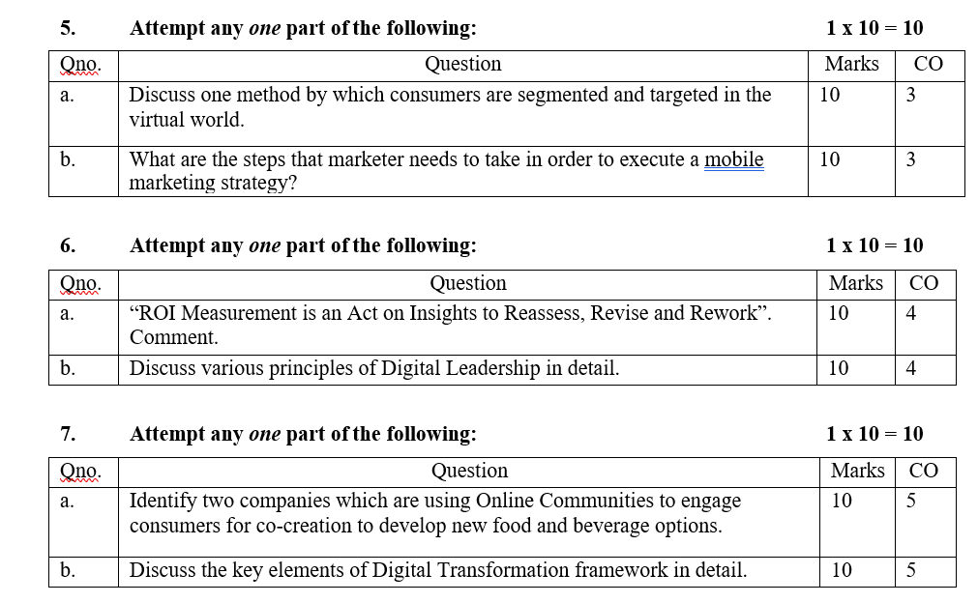
End Semester Question paper

Slide 97
Expected Questions for University Exams
Define the term 'digital organization’.
Discuss what does DT refer to?
Define what is Cloud computing?
Explain how does Online PR work?
Explain what does website structure refer to?
Explain how is Online PR different from traditional PR?
Discuss the methods for calculating Social media marketing ROI.
Discuss what does the term 'SMACIT' imply in terms of technology?

Slide 98
University Paper Link
https://www.uptunotes.com/aktu-paper-digital-marketing-mammk04-2018-19/
http://www.aktuonline.com/papers/mba-3-sem-digital-and-social-media-marketing-kmbmk03-2020.pdf
http://www.aktuonline.com/papers/mba-3-sem-digital-marketing-rmbmk03-2020.html
http://www.aktuonline.com/papers/mba-3-sem-digital-marketing-rmbmk-03-2018-19.html

Slide 99
Summary
Many businesses have implemented or are planning digital transformation programmes to take advantages of the opportunities of digital media and technology to increase sales.

Slide 100
References
https://www.commonplaces.com/blog/the-importance-of-website-planning
https://www.spiralytics.com/blog/what-are-dynamic-websites/
Moutsy Maiti: Internet Mareting, Oxford University Press India
andana, Ahuja; Digital Marketing, Oxford University Press India (November, 2015).
Eric Greenberg, and Kates, Alexander; Strategic Digital Marketing: Top Digital Experts Share the Formula for Tangible Returns on Your Marketing Investment; McGraw-Hill Professional (October, 2013).
Ryan, Damian; Understanding Digital Marketing: marketing strategies for engaging the digital generation; Kogan Page (3rd Edition, 2014).

